Slide 1
Attendance management system using blockchain
Presented by:-
2010030463 – M.Anil Kumar
2010030490 – K.Varun Krishna
2010030475 – Siddarth Sri Sai
Guided by:-
Lalitha Surya Kumari Mam’m

Slide 2
Table of contents
INTRODUCTION
DOCUMENTATION
FLOW CHART
GITHUB COMMITS
WORK PROGRESS
ALPHA TESTING

Slide 3
Introduction
Many of the present attendance management systems use the conventional systems, here we cannot determine the authenticity of the databases.
Blockchain system is distributed and decentralized that make it can be applied to develop a tamper proof attendance system.
using Blockchain technology, no person can deny that he did changes to the database.
The blockchain-based attendance system is required to provide a database that keeps its reliability and integrity and tamper proof.
The control lies in every person that can access the Blockchain.

Slide 4
FLOW CHART
LOGIN INTERFACE
ENTER THE USER CREDENTIALS
SELECT THE CLASS AND DATE
STORE THE ATTENDACE
BLOCK 1 HAS BEEN ADDED
REPEAT
BLOCK ‘N’ HAS BEEN ADDED
TO RETRIVE PREVIOUS DATA
LOGIN USER CREDENTIALS
VIEW PREVIOUS REORDS
RECORDS DISPLAYED

Slide 5
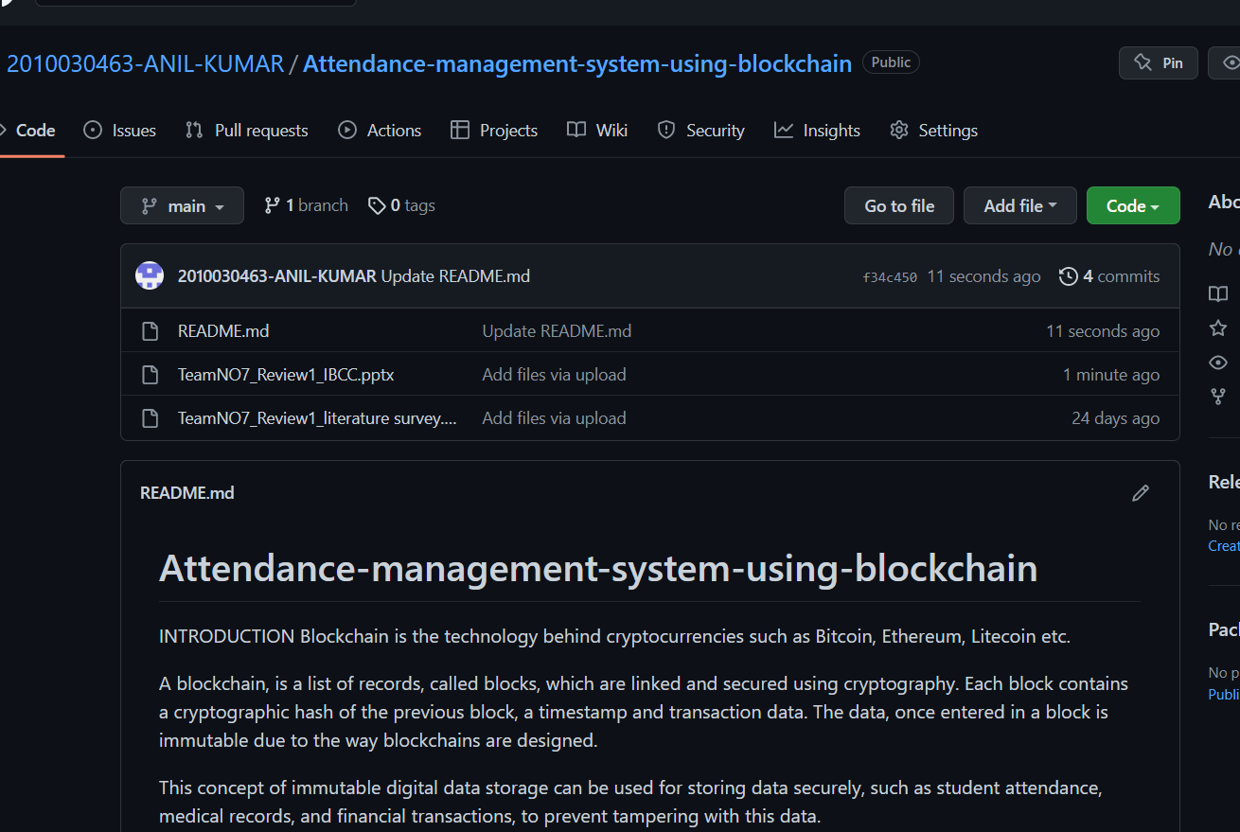
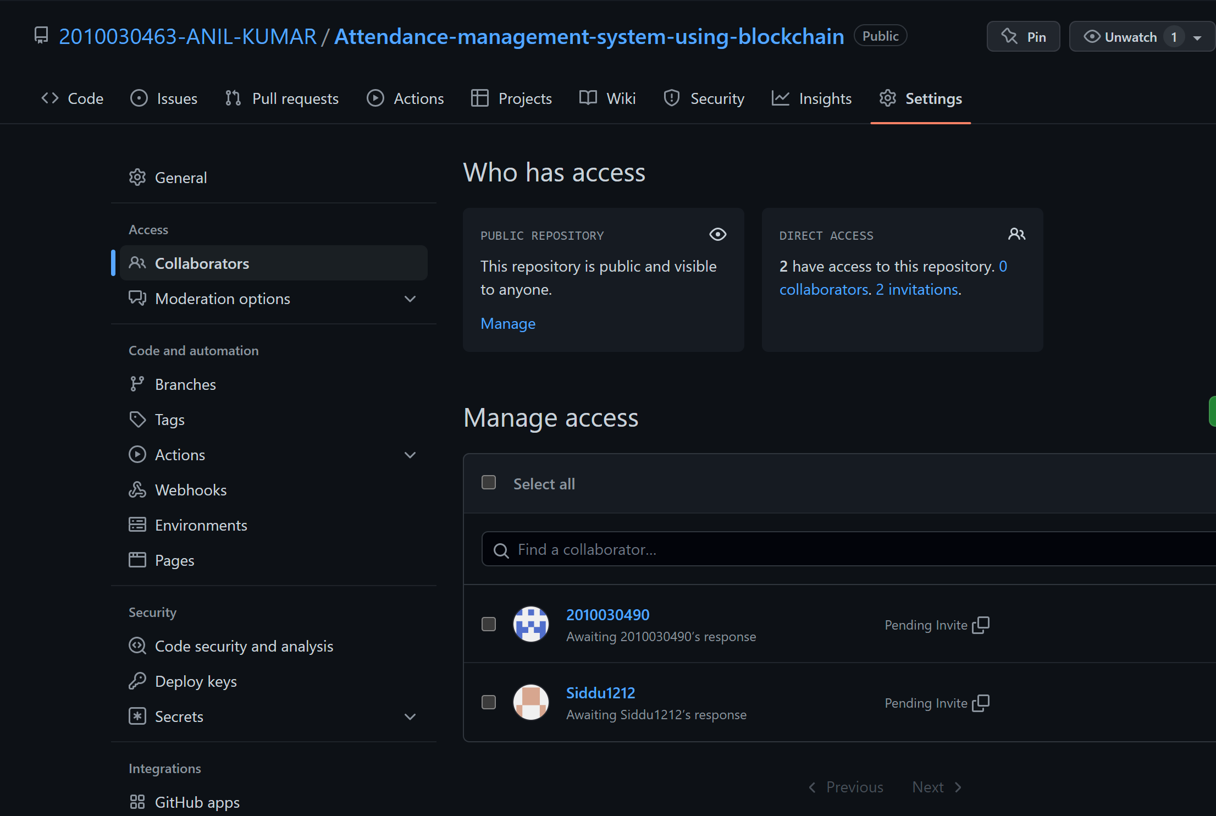
Github Commits

Slide 6
WORK PROGRESS
Implementing blockchain for secure data storage.
Storing student attendance data along with their roll numbers in the blockchain.
Retrieval of data from the blockchain.
Web interface for insertion and retrieval of data.
Ability to check if a block has been tampered with.

Slide 7
ALPHA TESTING

Slide 8
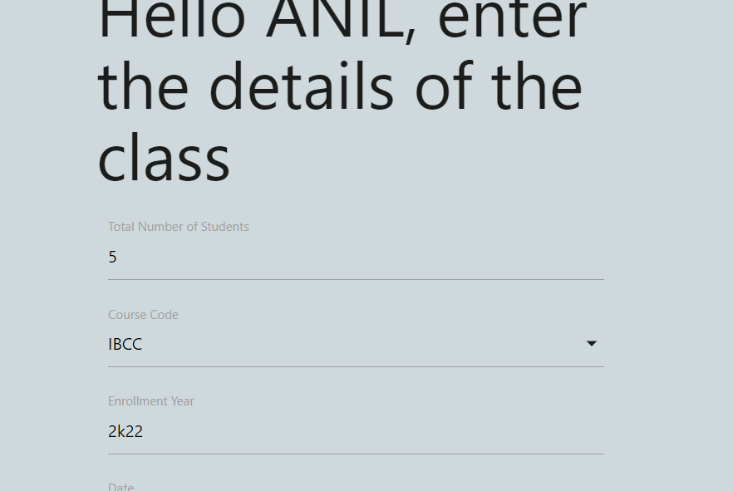
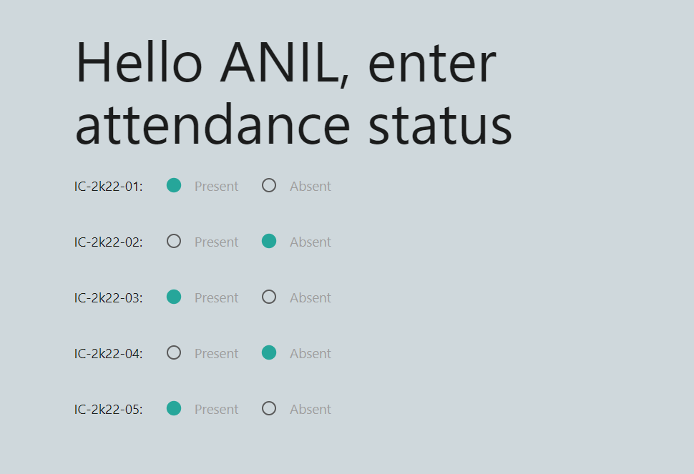
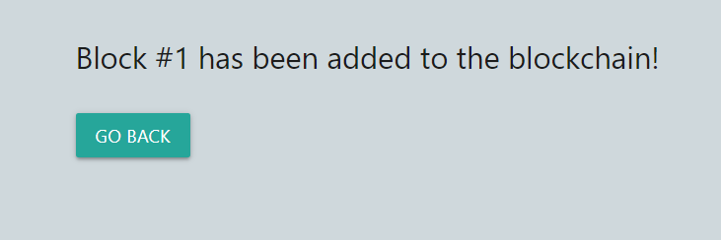

Slide 9
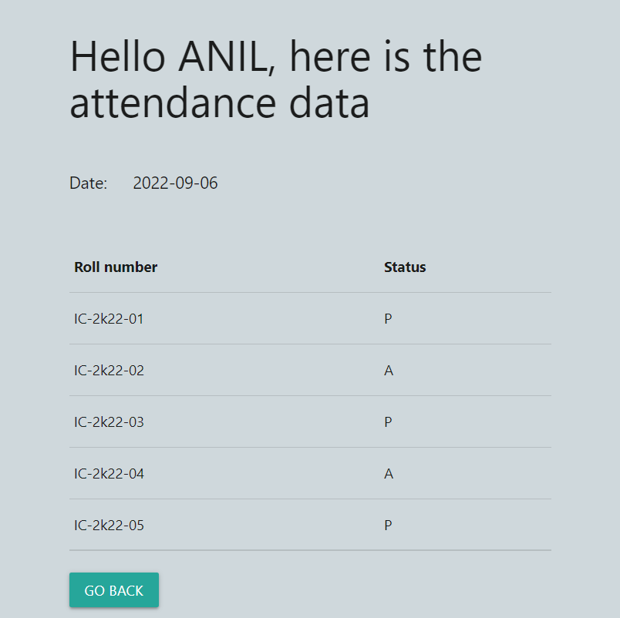
TO RETRIVE THE PREVIOUS DATA

Slide 10
Work Allocation
Coding – M.Anil kumar
Documentation and Testing– K.Varun krishna
Web design - Siddarth Sri Sai

